Slide 1
Tere hommikust This show is for the memory of Jakob Hameiry (Yanci Maisel) born in Viliandi, 01/07/1913, died in Haifa in 19/11/1988. Dov Hameiry (Bernard/Bebu Maisel) born in Viliandi, 10/01/1917, died in Kfar-Blum in 12/08/1991. And for the memory of Maisel family members who were murdered in Tallinn, the parents Meir & Rosa Maisel, a brother and sisters: Abram, Hanci, Zelda, Rachil, Haja. Lately lived in 36, Jakobsoni st. Tallin.

Slide 2
Youth movement Tallinn 15/10/1933

Slide 3
Kibbutz training in Tallinn 11/11/1933

Slide 4
Yanci as a guard

Slide 5
Kibbutz training Tallinn 10/05/1934 “See you in the Kibbutz in our country"

Slide 6
Young and shy – Dov with 2 girls

Slide 8
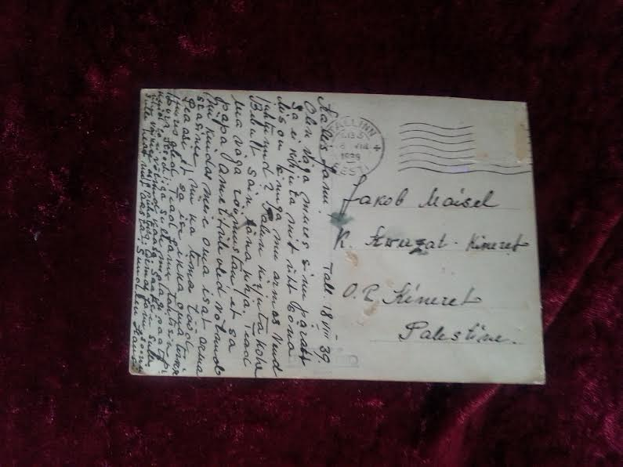

Slide 9
Same place - 60 years later

Slide 10
Yanci & Bebu 1943

Slide 11
Suur aitäh kuulata

